Slide 1

PA Bird Atlas - 3 Franklin Co.
Year 1

Slide 2


AGENDA
“Everyone likes birds. What wild creature is more accessible to our eyes and ears, as close to us and everyone in the world, as universal as a bird?”
-Sir David Attenborough.
 | Atlas Refreshers Objectives Block breakdown Checklist guidelines Breeding Codes
 | Franklin Co. Winter Atlas Block Data & Species Documented Priority Species Franklin Block Help Thank You!

Slide 3
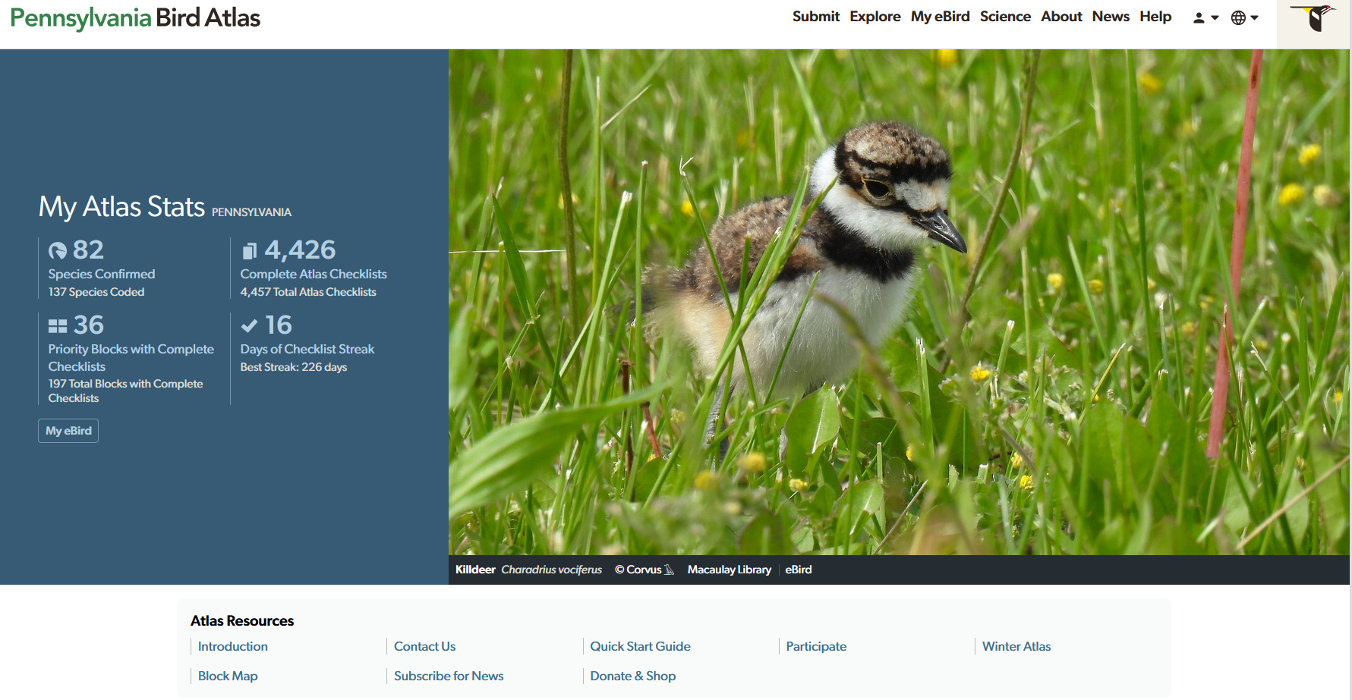
https://ebird.org/atlaspa/home

Slide 4

PA Bird Atlas – 3
OBJECTIVES
Produce results that can be compared to previous Pennsylvania bird atlases.
Provide data suitable for status updates and conservation of bird species and their habitats.
Document all bird species breeding in Pennsylvania and estimate their distributions.
Estimate relative abundance for most of the bird species breeding in Pennsylvania.
Achieve uniform coverage of the state by observers.
Ensure that results are accessible to decision makers and, when appropriate, the public, through publication online, in a major database, and in book format.
Make participation in the PBA3 accessible and inclusive.
Raise awareness of birds in Pennsylvania, factors driving changes in their populations, and efforts to conserve them.
Encourage collaborations with relevant organizations, government departments, and community groups.
The PBA3 will attempt to document all the breeding bird species of Pennsylvania, confirm as many of them as possible, produce relative abundance estimates, and update range maps to look for evidence of population changes and distributional changes.

Slide 5
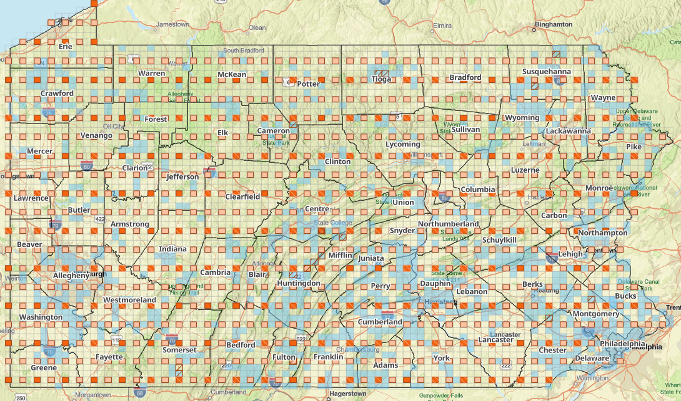
Block breakdown
The PBA3 will use the same ‘block’ system as the two previous atlases.
Pennsylvania is gridded into 7.5-minute (1:24,000) U.S. Geological Survey quadrangles (quads).
Each quad is subdivided into 6 blocks for a total of 4,938 blocks across the state. Blocks are each roughly 3 x 3 miles, totaling about 9 mi2 (23 km2), except for blocks along borders of the state, which may be irregularly shaped and sized.
Each block is given the name of the quad it is located in followed by a 2-letter code denoting the position of the block within the quad: northwest (NW), northeast (NE), center-west (CW), center-east (CE), southwest (SW), or southeast (SE).
By birding in all 4,938 blocks in Pennsylvania, we can detect shifts in species distributions between atlases. All southeast (SE) blocks are designated as ‘Priority’ blocks.

Slide 6
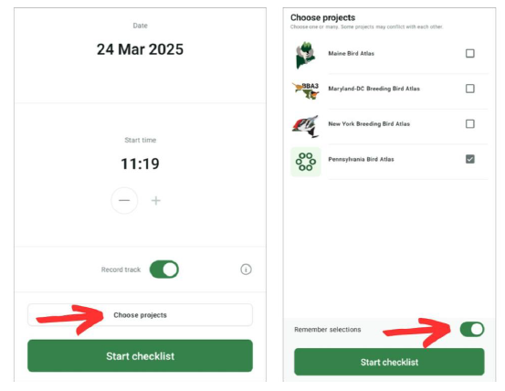

CHECKLIST GUIDELINES
Keep separate checklists for different habitat patches within a block.
Keep your traveling distance short – 1 mile or less.
Keep duration of checklists short – 1 hour or less.
Take care to stay within boundaries of a single block for each checklist. eBird hotspots frequently cover multiple blocks and therefore should often not be used when you select your location. Instead, create separate checklists for each block and assign a specific personal location to each checklist.
Slow down, watch bird behaviors, and use breeding codes!
A list of guidelines to help ensure that the observations you collect can be used by the PBA3.
Checklists MUST be submitted to the Pennsylvania Bird Atlas portal on your mobile device or at ebird.org/atlaspa/submit.
Provide a count or estimate of the number of individuals reported instead of ‘X.’

Slide 7
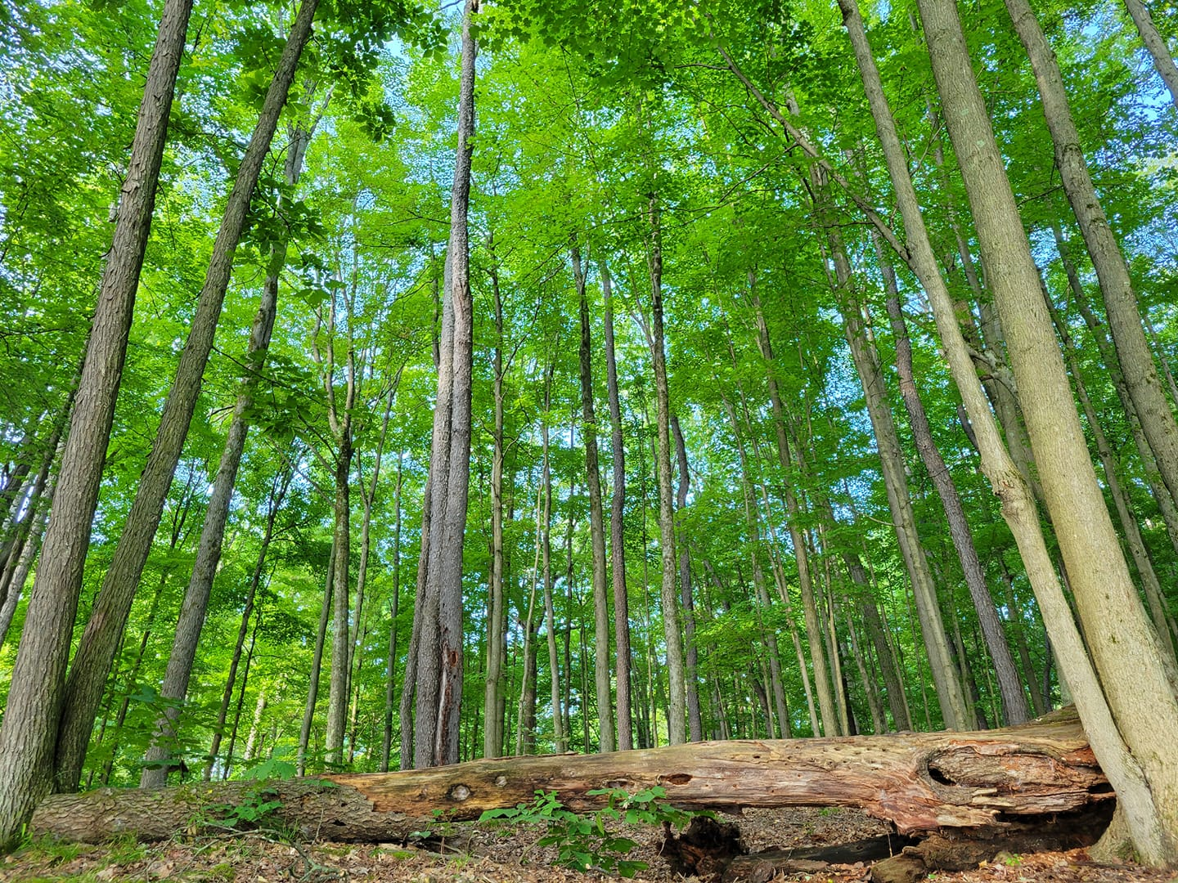
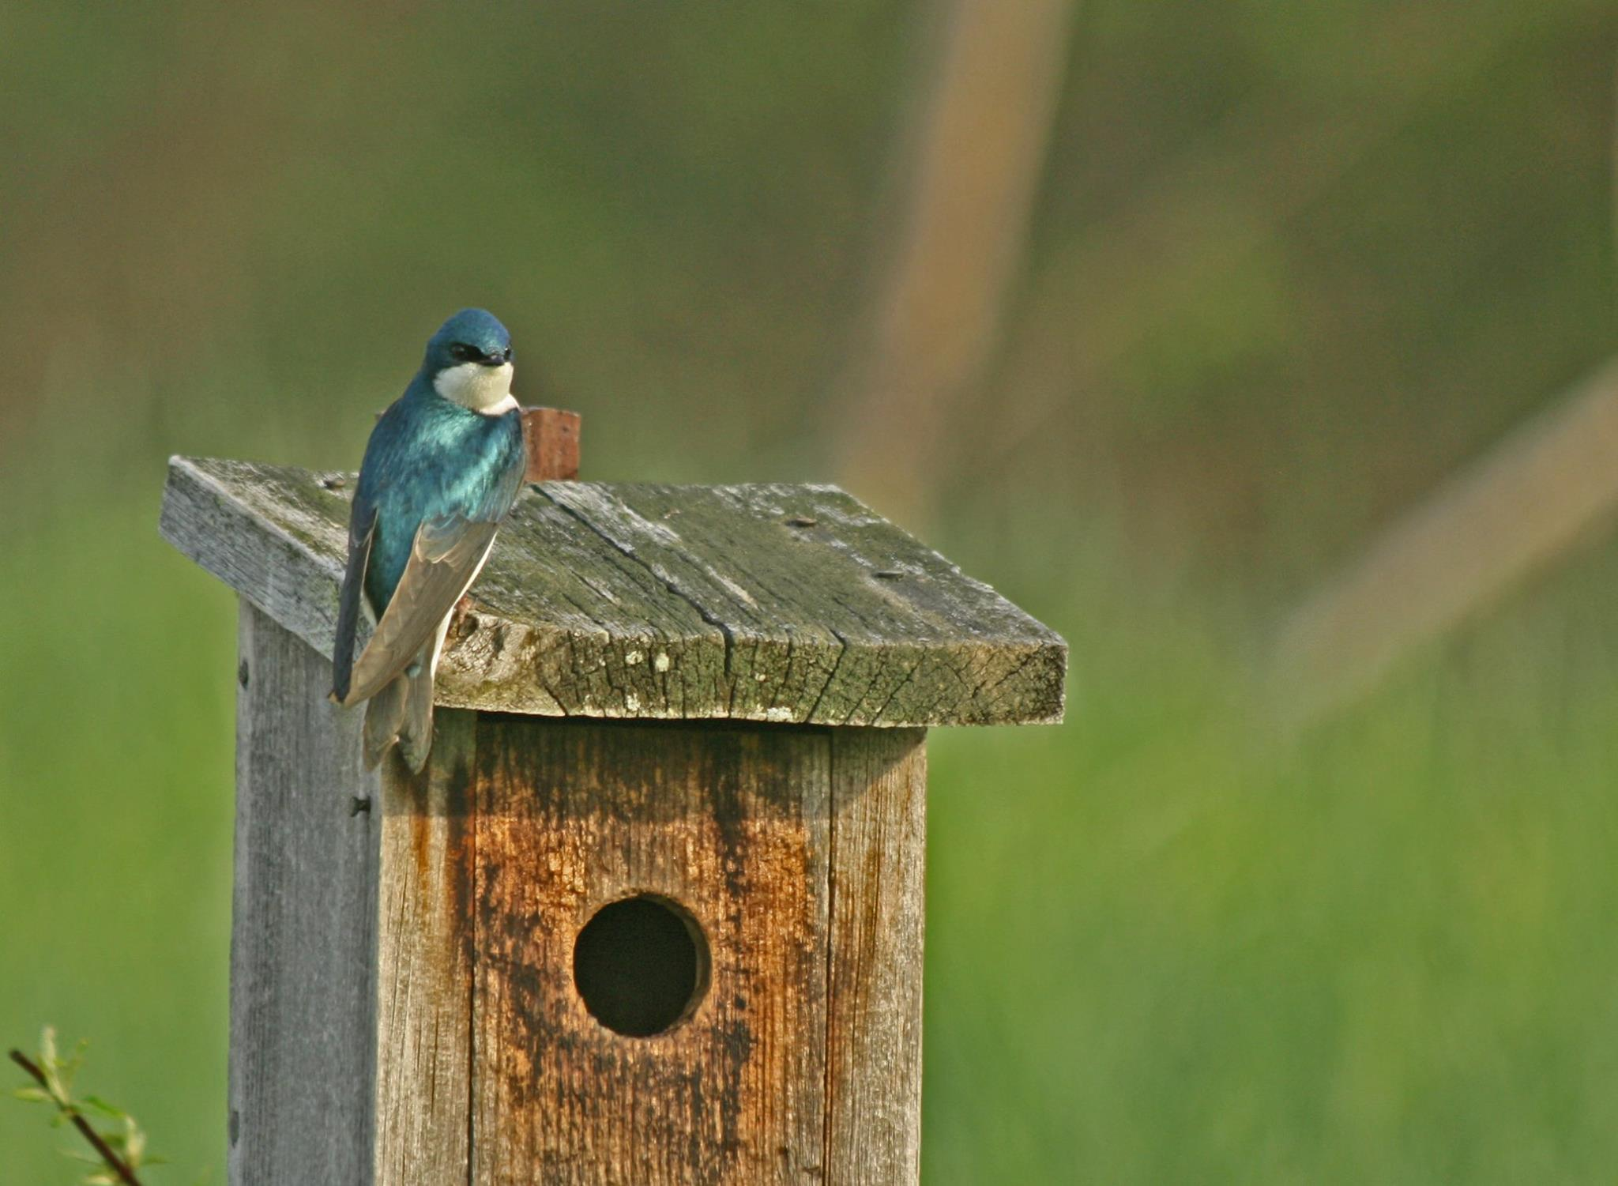
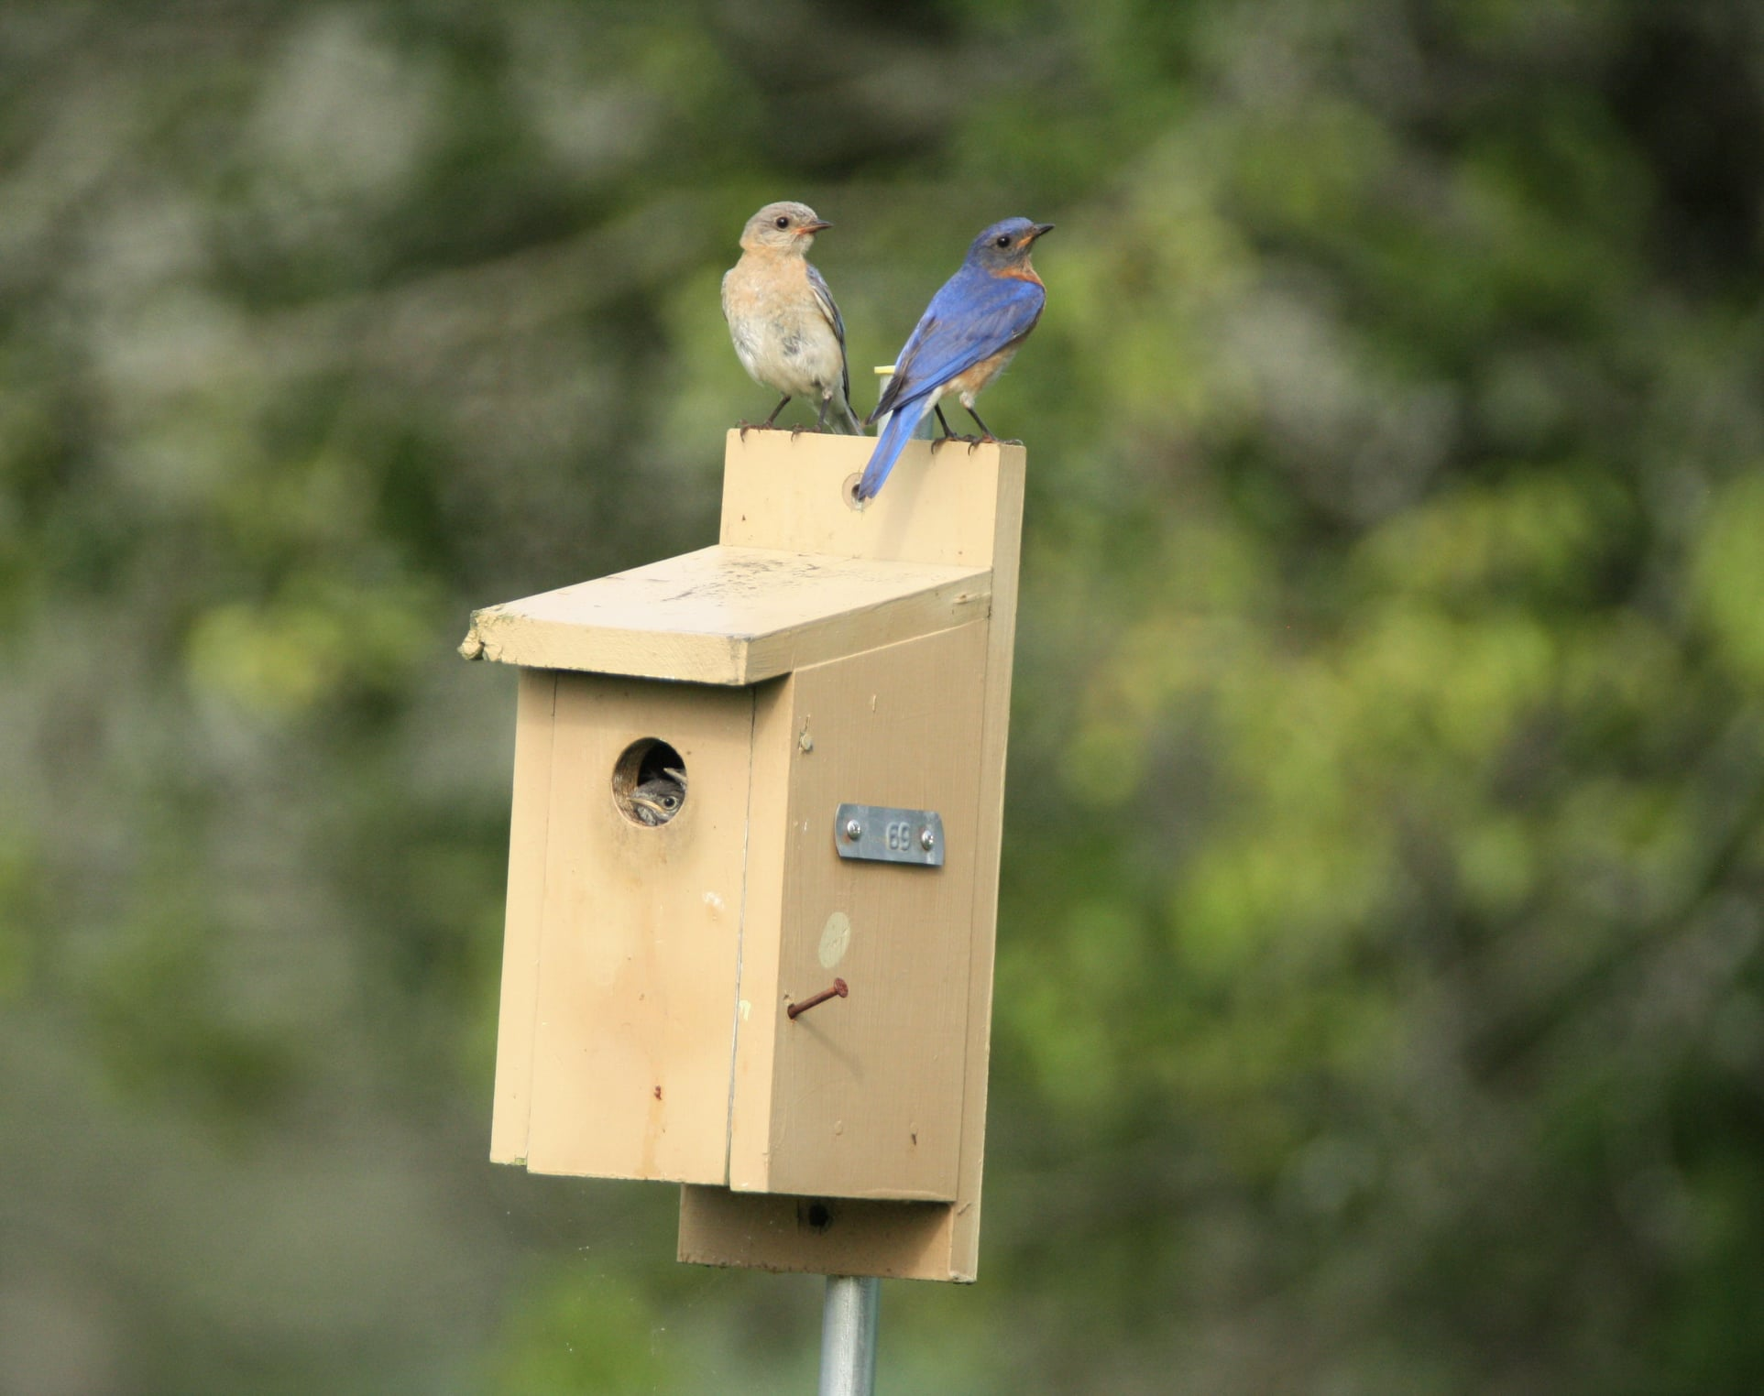



Breeding codes
Possible: H (In Appropriate Habitat); S (Singing Bird in Appropriate Habitat)
Probable: S7 (Singing Bird Present 7+ Days); M (7+ Singing Birds); P (Pair in Suitable Habitat); T (Territorial Defense); C (Courtship, Display, or Copulation); N (Visiting Probable Nest Site); A (Agitated Behavior); B (Wren/Woodpecker Nest Building)
Confirmed: PE (Physiological Evidence); CN (Carrying Nesting Material); NB (Nest Building); DD (Distraction Display); UN (Used Nest); ON (Occupied Nest); FL (Recently Fledged Young); CF (Carrying Food); FY (Feeding Young); FS (Carrying Fecal Sac); NE (Nest with Eggs); NY (Nest with Young)

Slide 8
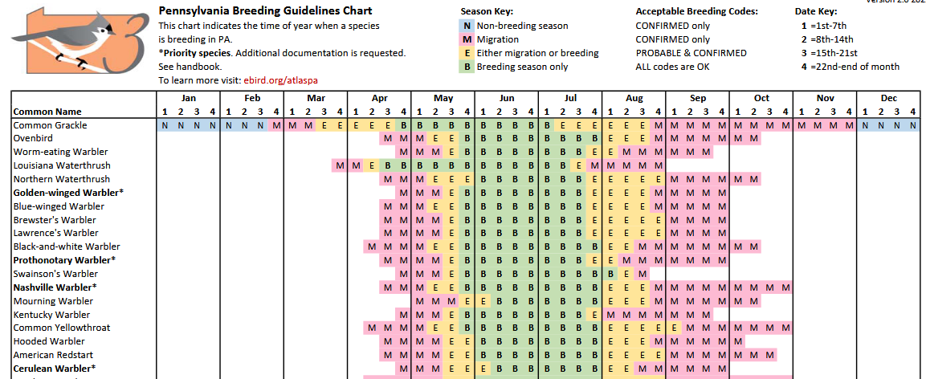
PA Breeding Guidelines chart

Slide 9
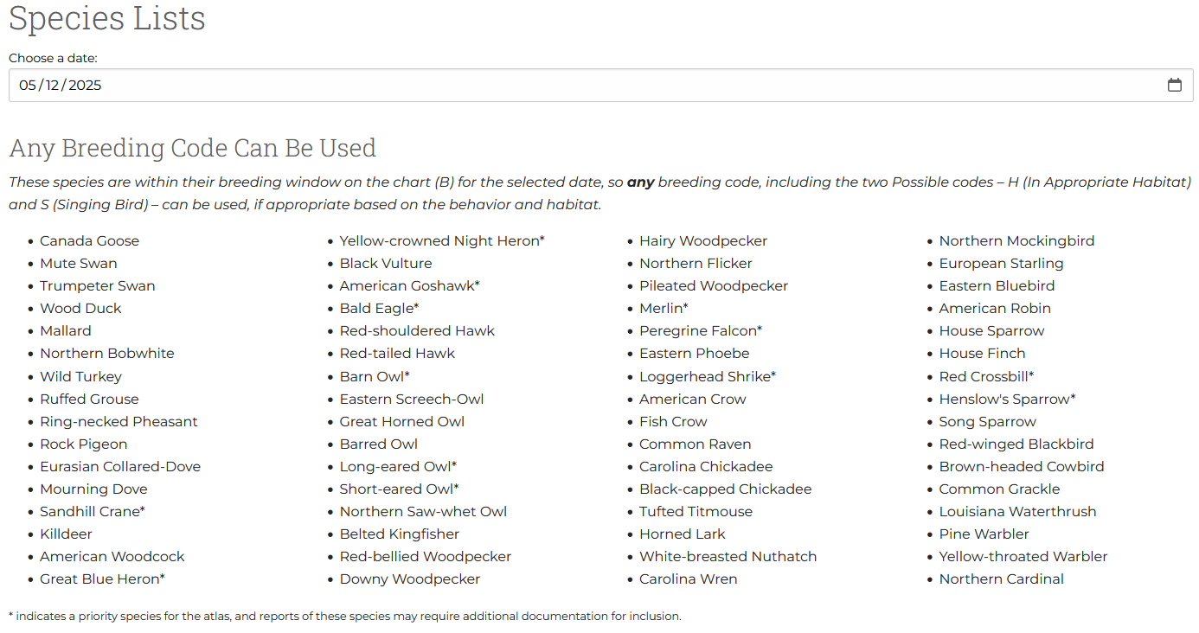
Simplified Breeding Codes Tool (LycoBirds)

Slide 10
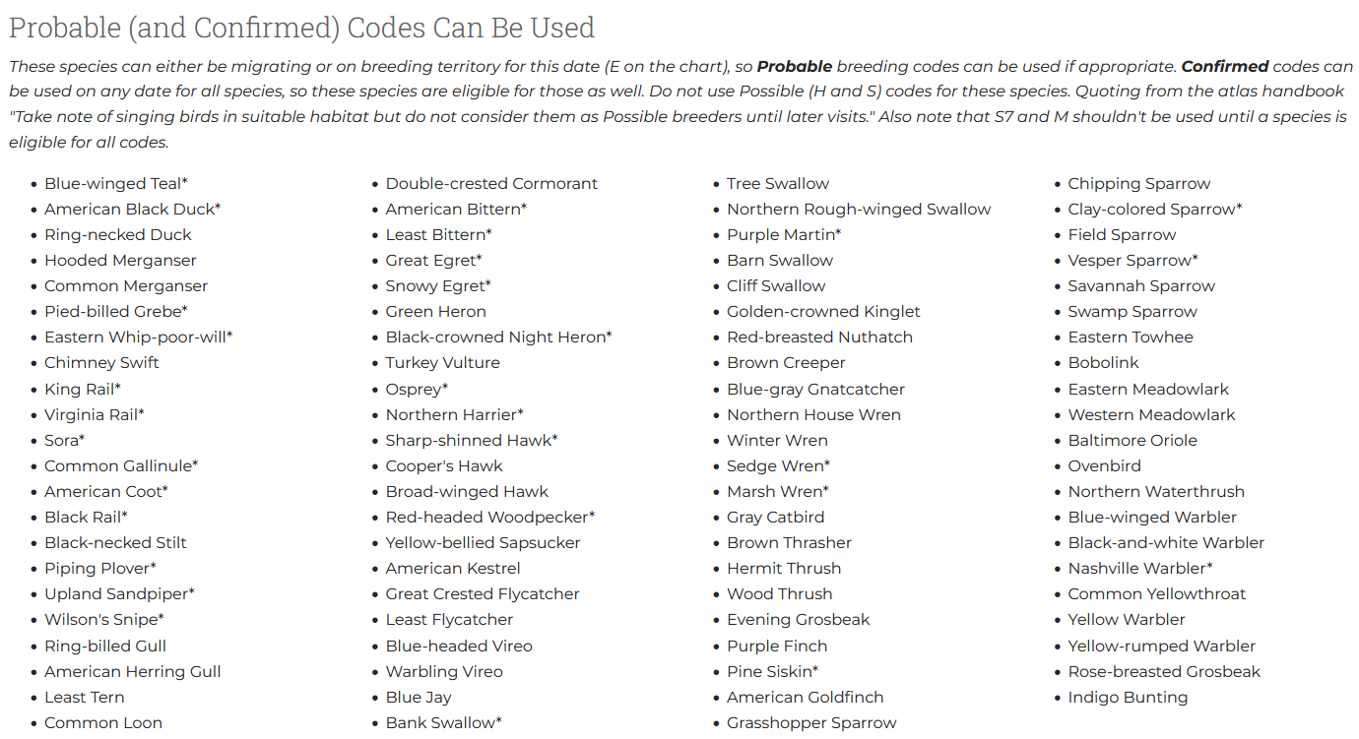
Simplified Breeding Codes Tool (LycoBirds)

Slide 11
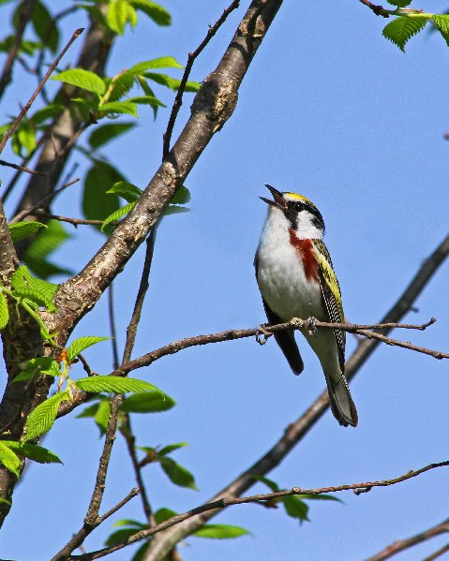
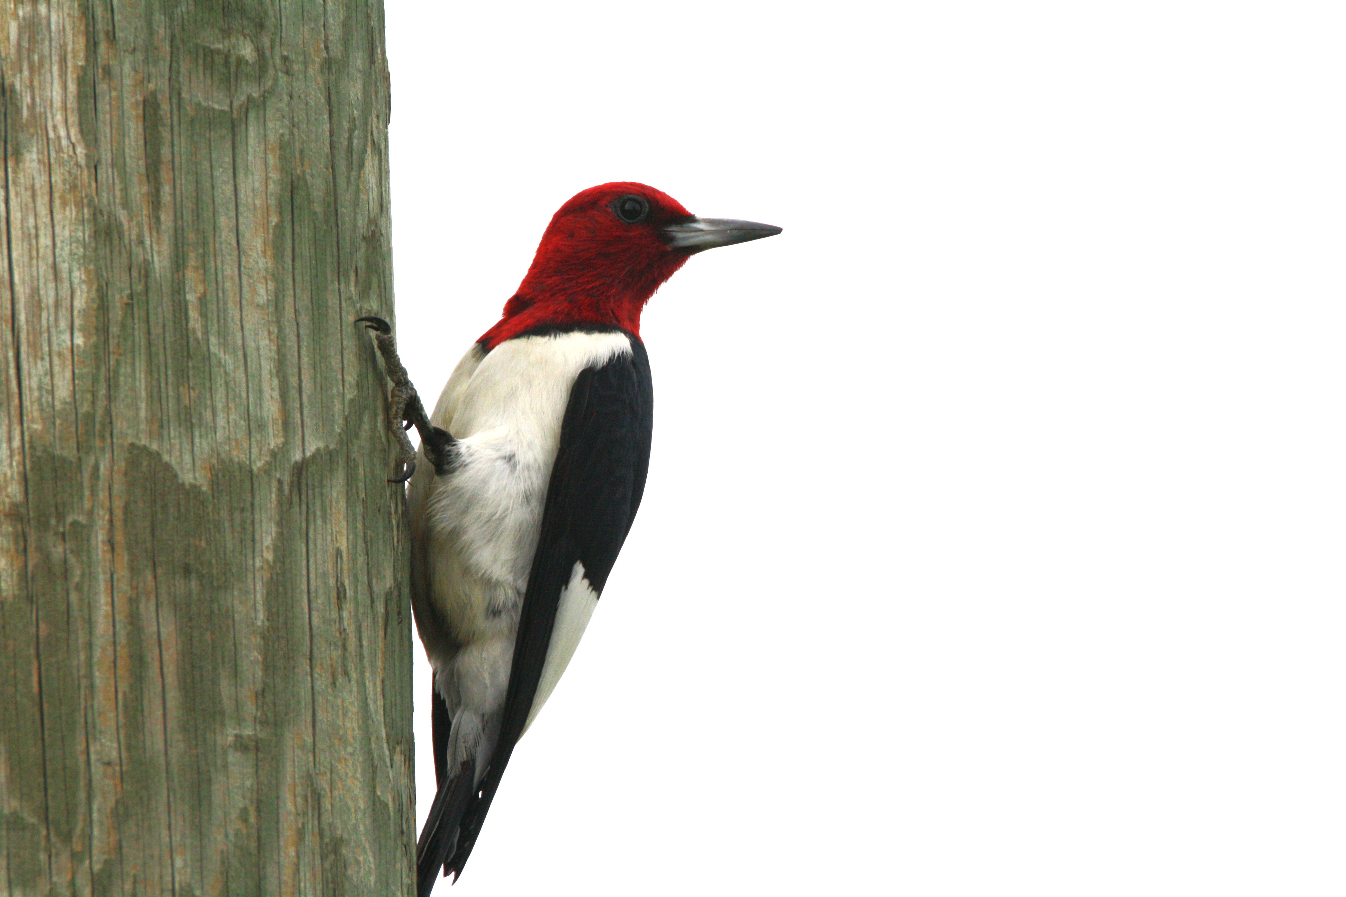
AVOID BREEDING STATUS CODING ERRORS
OVERCODING OCCURS WHEN CODES ARE USED PREMATURELY OR IN ERROR
Use of “POSSIBLE” codes H (IN APPROPRIATE HABITAT) or S (SINGING BIRD IN APPROPRIATE HABITAT) before the species is in their breeding only time period on the breeding guidelines chart.
Use of “PROBABLE” codes S7 (SINGING BIRD PRESENT 7+ DAYS) or M (7+ SINGING BIRDS) before the species is in their breeding only time period on the breeding guidelines chart.
Use of M (7+ SINGING BIRDS) when the number being reported is less than seven. There should be seven or more same species singing birds within a distance of one mile for this code to be used.
WOODPECKERS
Calling is not singing, so can only use H (IN APPROPRIATE HABITAT) if in breeding only time period on the breeding guideline chart.
Singing is drumming, so can use S (SINGING BIRD IN APPROPRIATE HABITAT) if in breeding only time period if you know what species is doing the drumming.
WOODPECKERS/WRENS NEST BUILDING
Coded differently because they build false nests/holes. Can use only a “PROBABLE” code B (WREN/WOODPECKER NEST BUILDING) for building nests/holes.

Slide 12

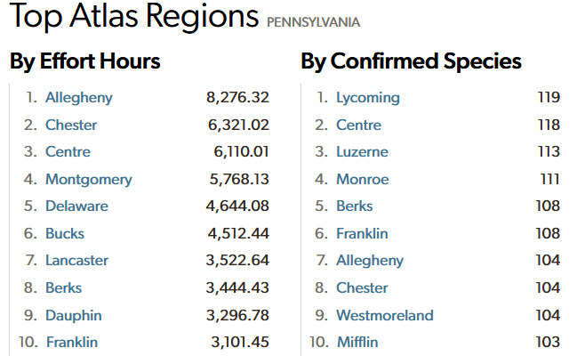
Franklin County

Slide 13


Winter Atlas - Franklin
To complete a Priority Block in the assigned winter season:
1. Conduct at least two daytime on-foot traveling surveys that are precisely 1-hour long, one in early winter (December 1 – January 15), and one in late winter (January 16 – February 28), ideally in different locations and habitats.
2. Survey the block for at least 6 hours (including the 1-hour surveys), with at least 3 hours in the early winter period and 3 hours in the late winter period.
3. At least one nocturnal survey is preferred (in accordance with nocturnal survey guidelines) but not required.
Franklin has completed its 2024-2025 Atlas Priority Blocks for the winter period, with 1-hour walks in all 5 blocks, as well as 2 hours or more additional hours of birding in each block
Big Cove Tannery SE (P)
Waynesboro SE (P)
Williamson SE (P)
Fannettsburg SE (P)
Shippensburg SE (P)

Slide 14
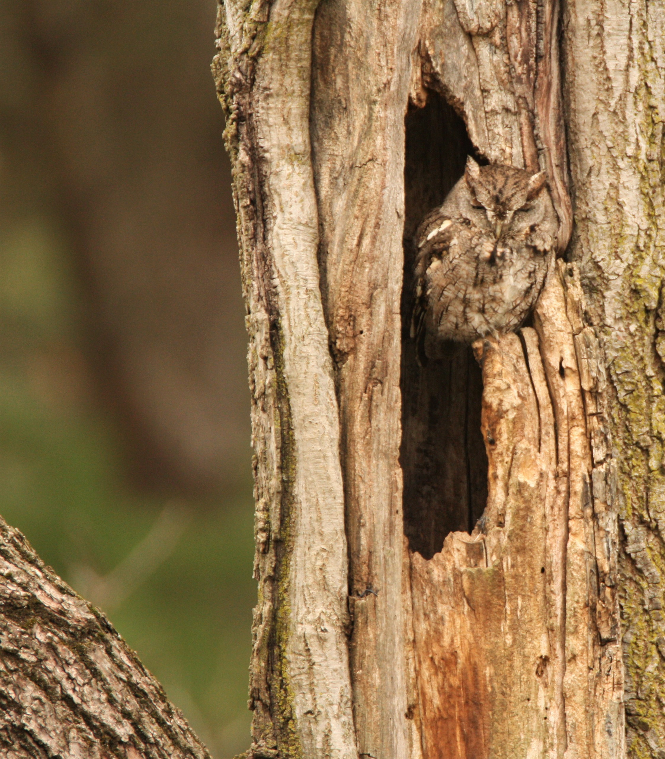
Winter priority block schedule
Greencastle SE (P) | 25/26
Mercersburg SE (P) | 25/26
Roxbury SE (P) | 25/26
Saint Thomas SE (P) | 26/27
Scotland SE (P) | 26/27
Shade Gap SE (P) | 26/27
Chambersburg SE (P) | 27/28
Doylesburg SE (P) | 27/28
Mcconnellsburg SE (P) | 27/28

Slide 15
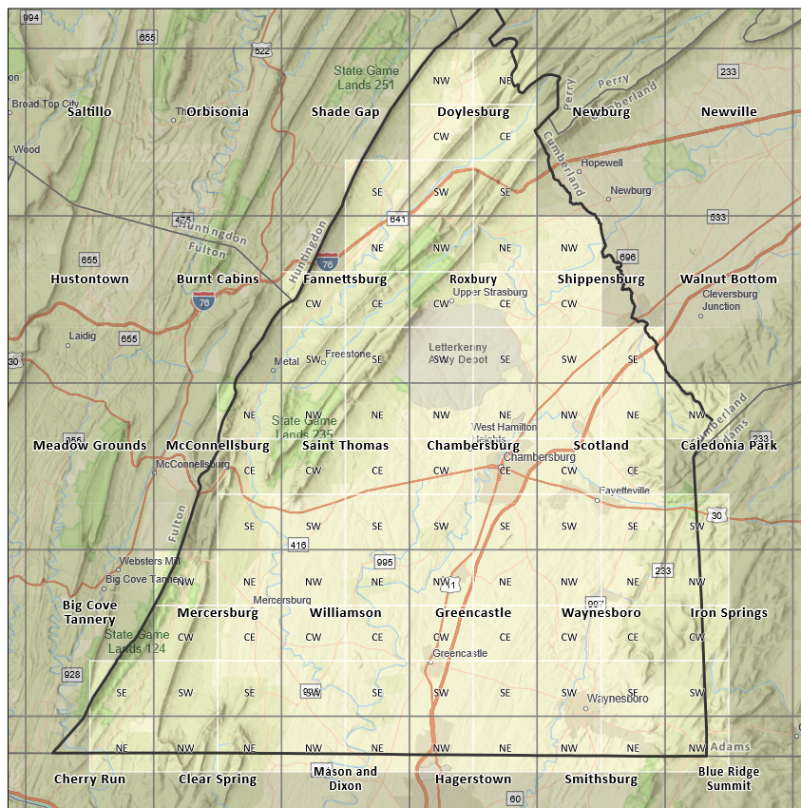
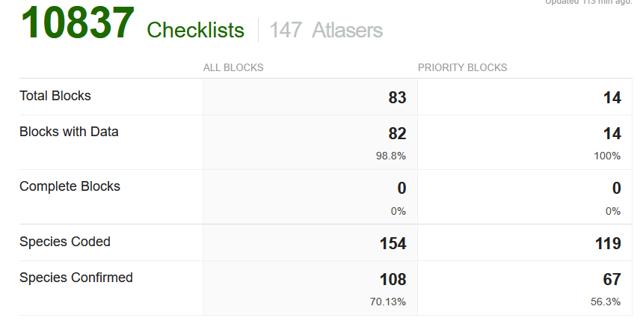
Franklin County Atlas Blocks
BREEDING ATLAS BLOCK COMPLETION TARGETS
70+ species* with breeding codes
  a. Minimum 25% Confirmed
  b. Maximum 25% Possible
  c. Remaining 50% Probable (or more may be Confirmed)
2. Minimum of 20 hours of Atlasing effort between April and August (over duration of the Atlas)
3. Minimum of 3 visits spread out across the breeding season (e.g., April, June, July)
4. Include checklists in all accessible habitat types (e.g., forest, grassland, agricultural fields, forested wetlands, marshes, urban habitats)
5. Minimum of 2 hours of nocturnal atlasing (preferably over 2 visits)

Slide 16
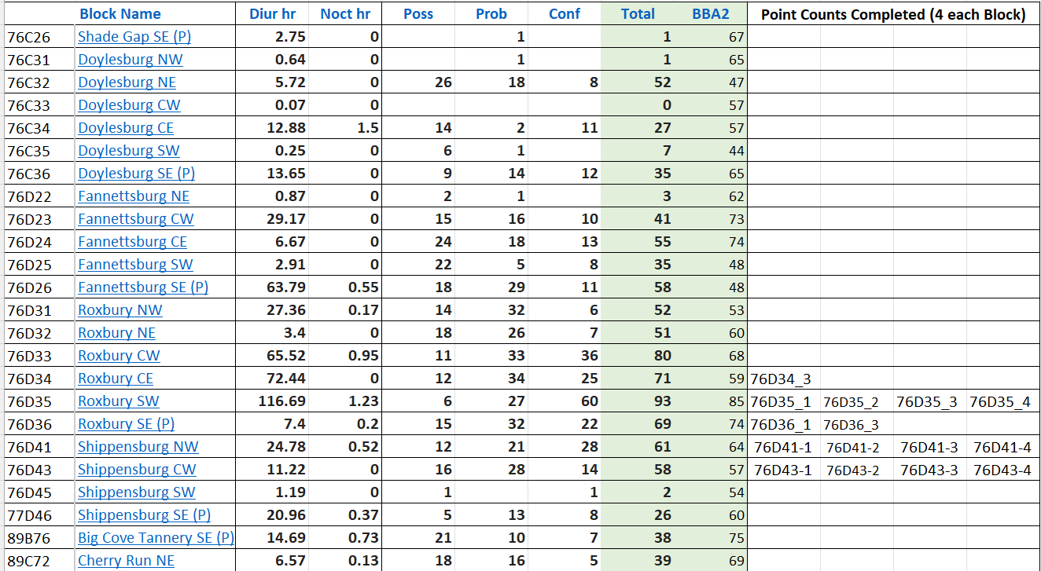

Slide 17
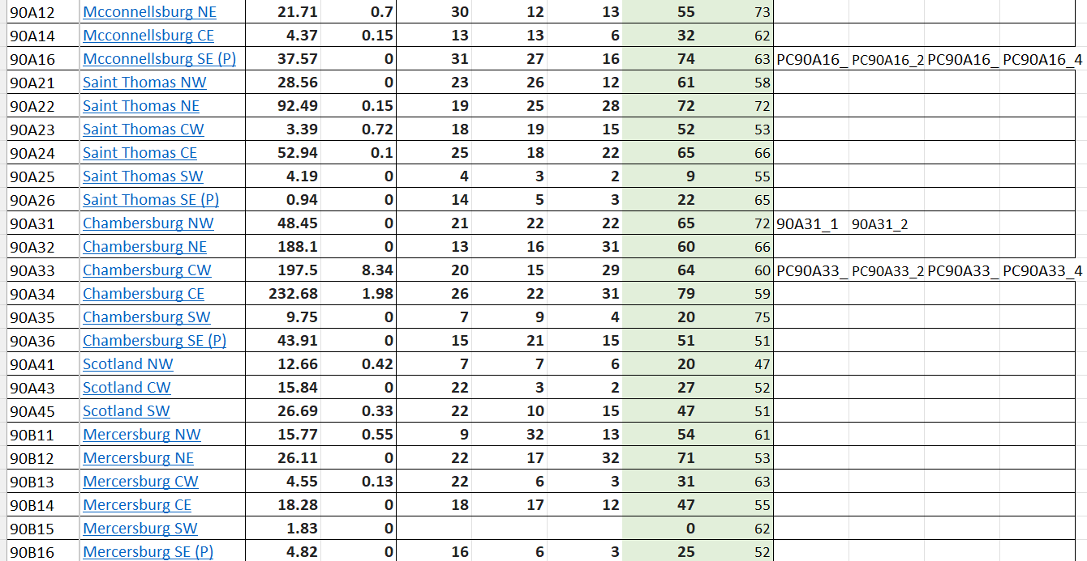

Slide 18
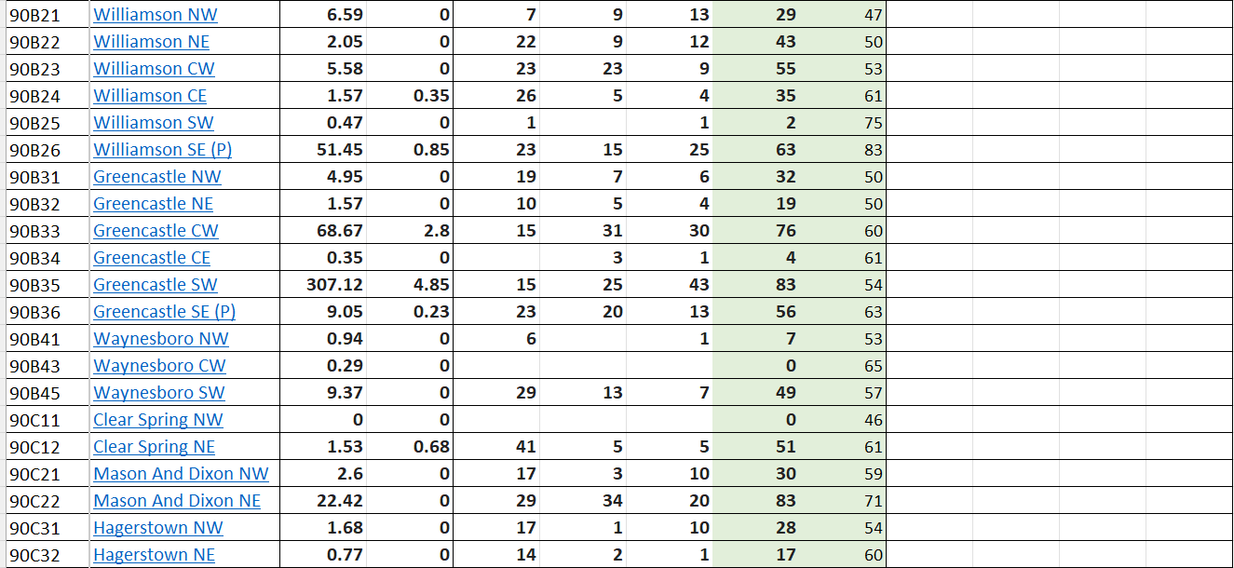

Slide 19
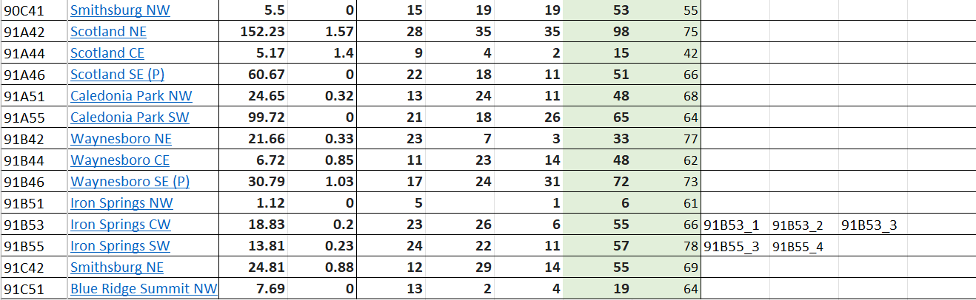

Slide 20
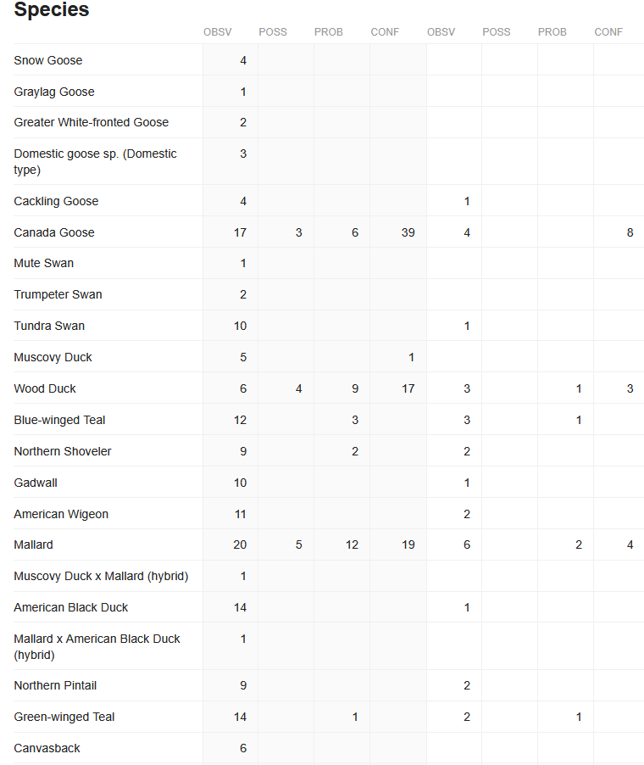
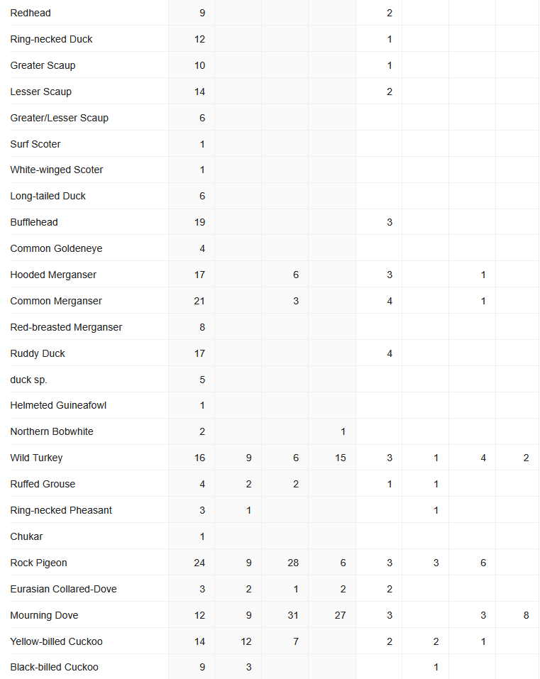
All Blocks
Priority Blocks

Slide 21
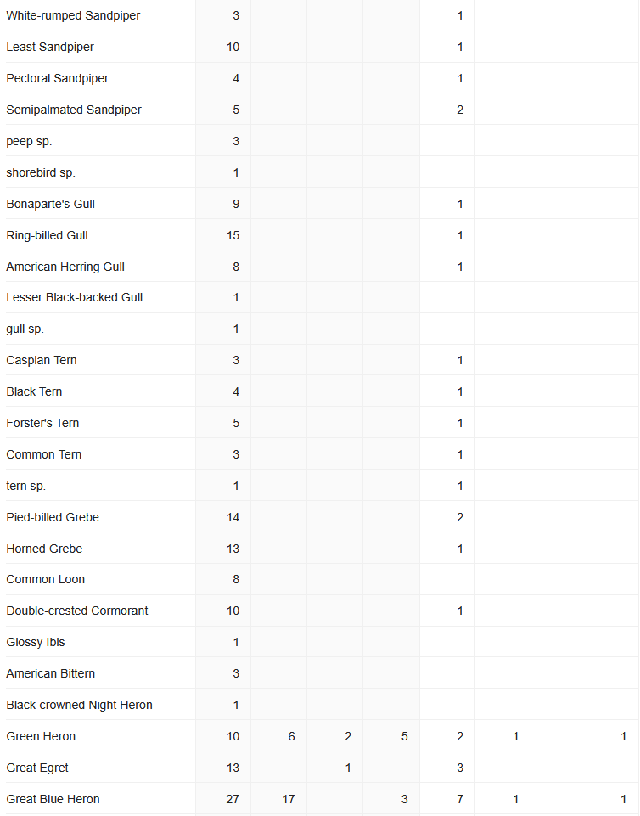
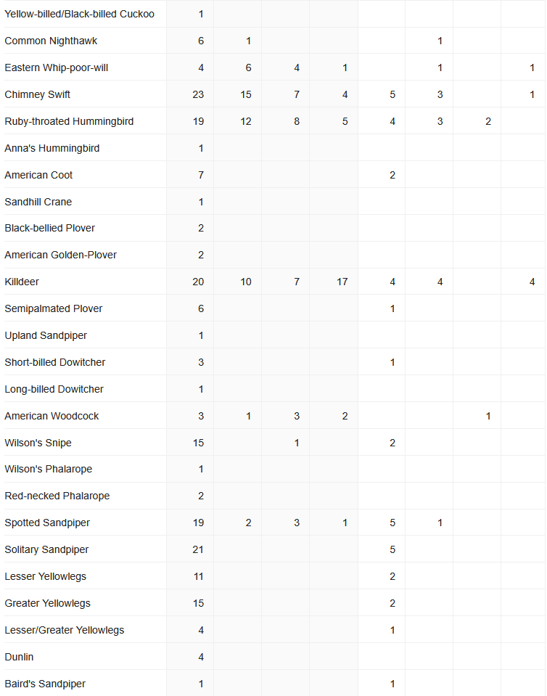
All Blocks
Priority Blocks

Slide 22
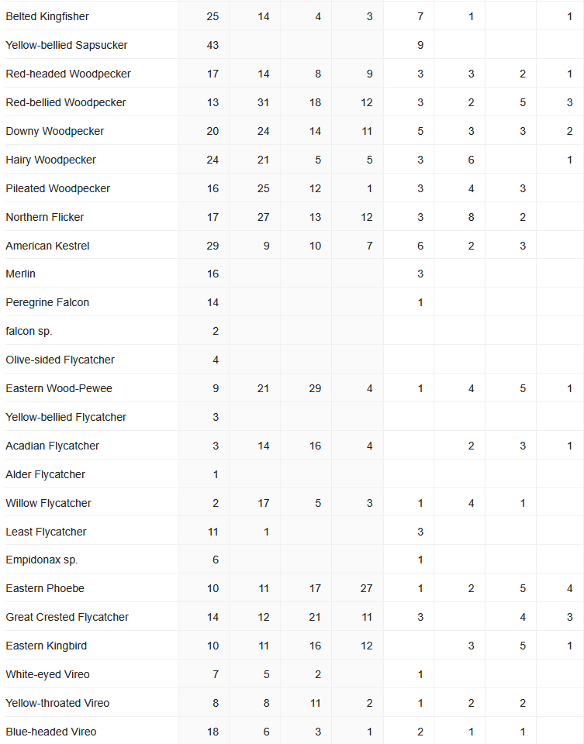
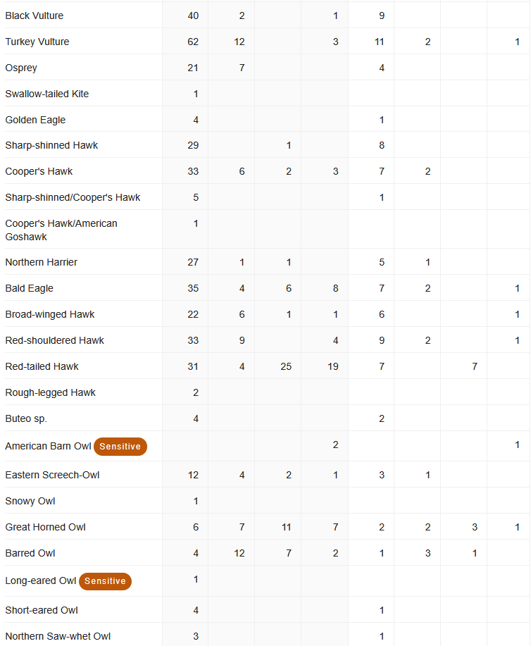
All Blocks
Priority Blocks

Slide 23
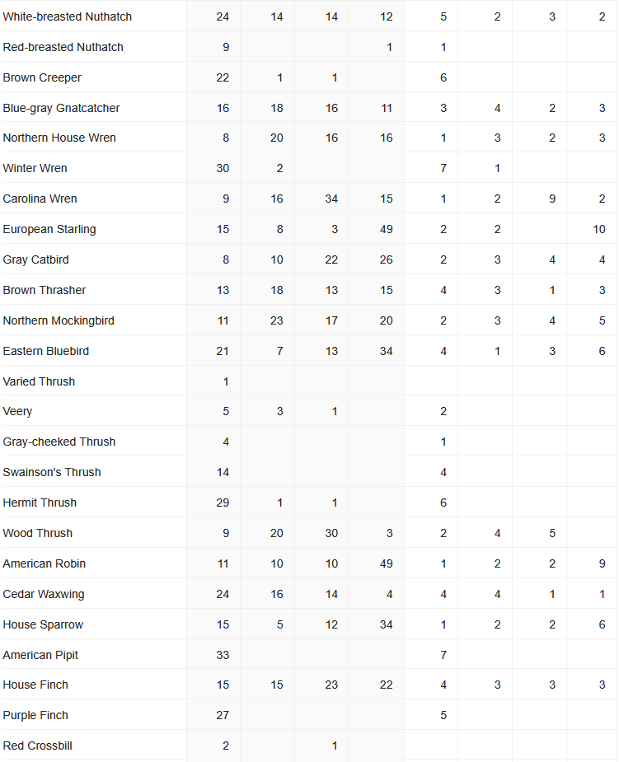
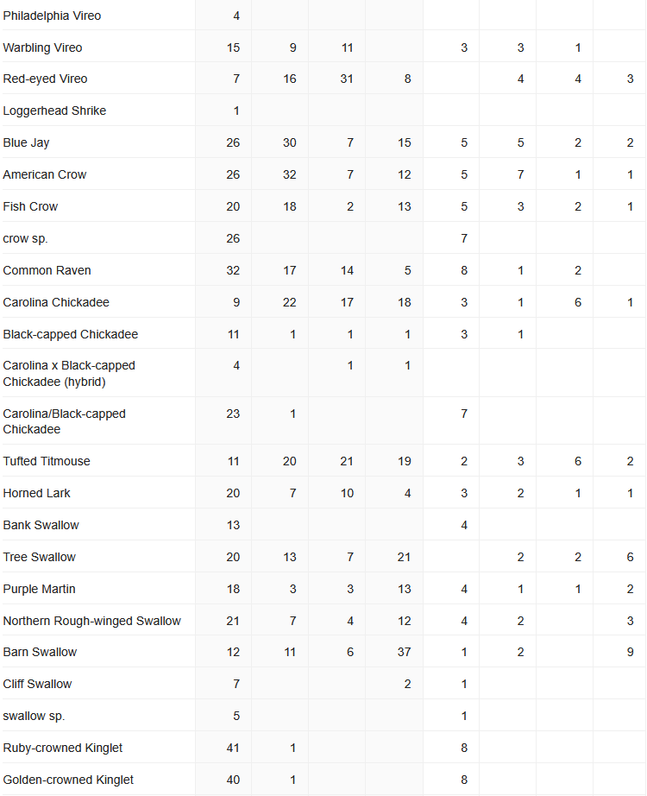
All Blocks
Priority Blocks

Slide 24
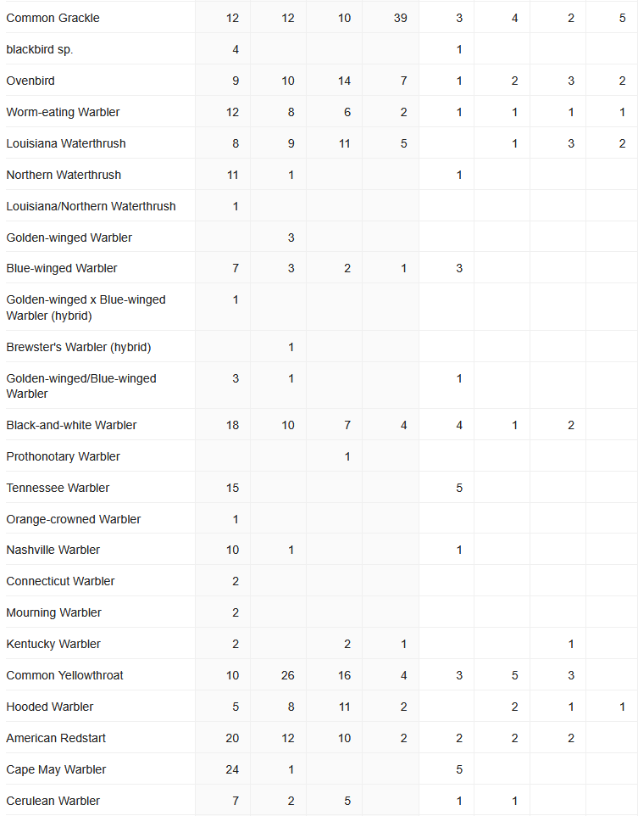
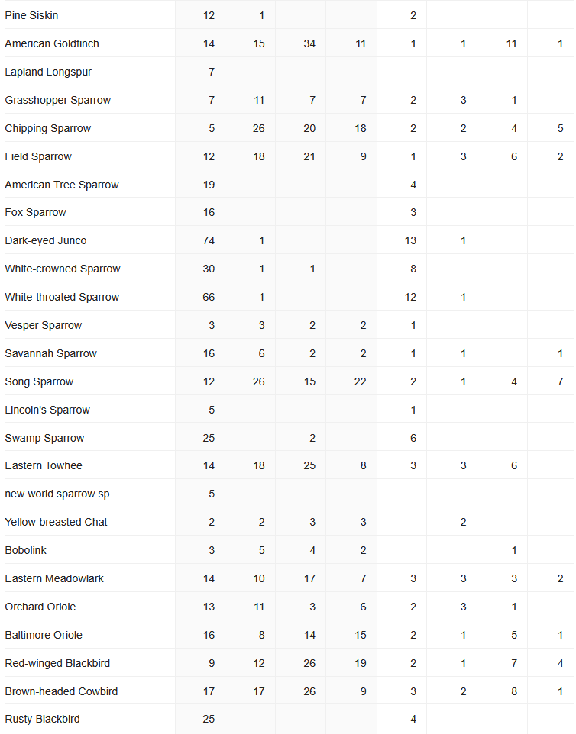
All Blocks
Priority Blocks

Slide 25
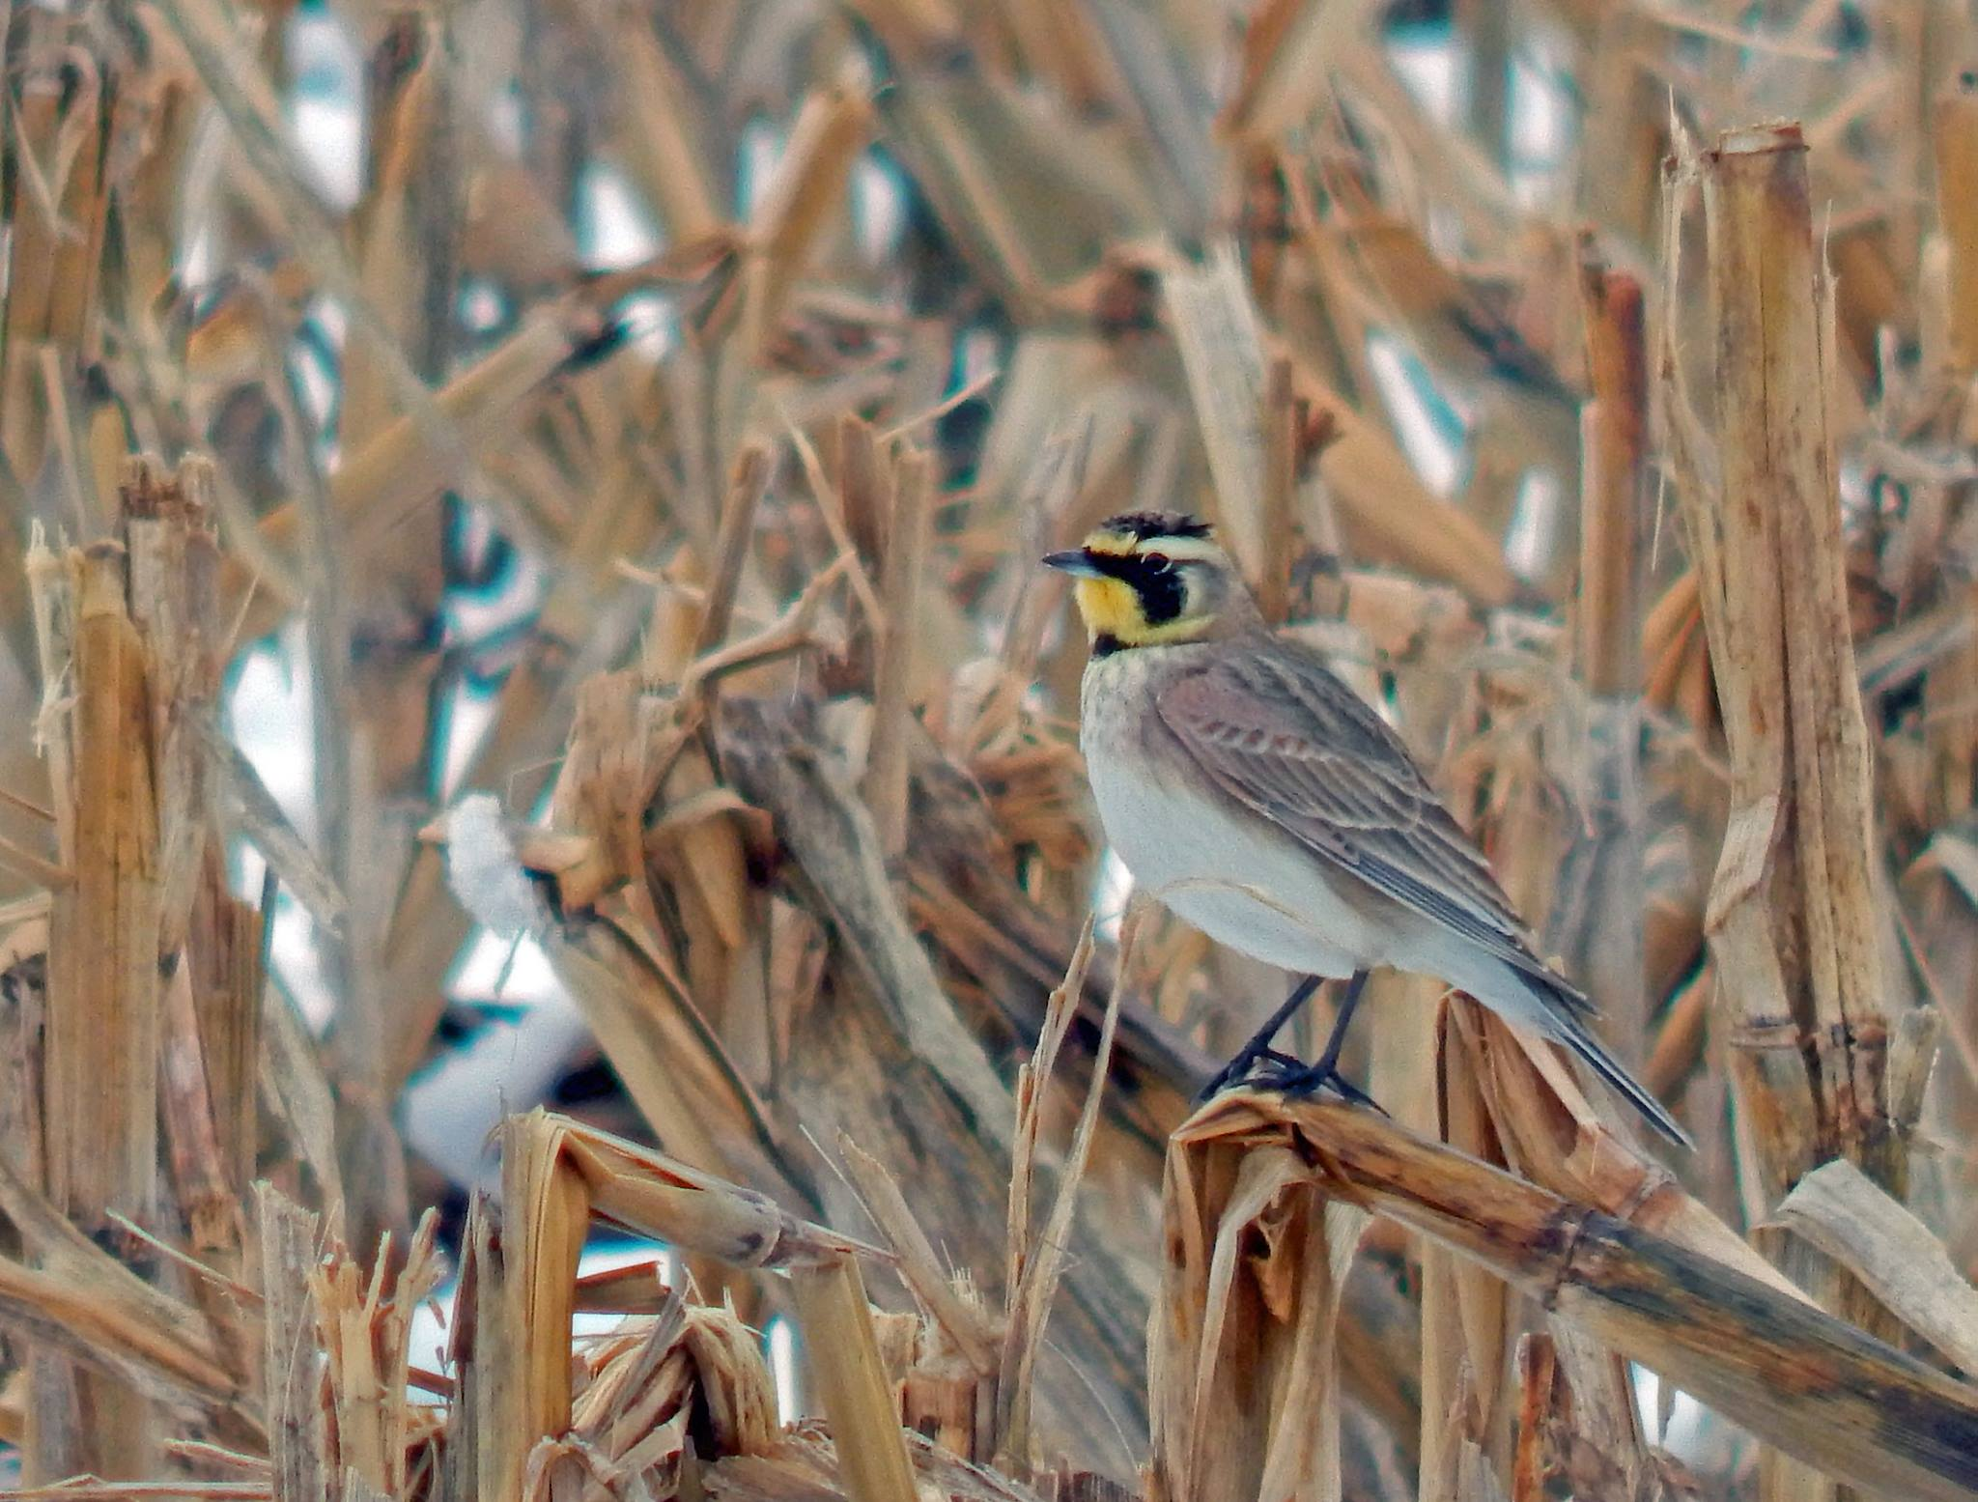
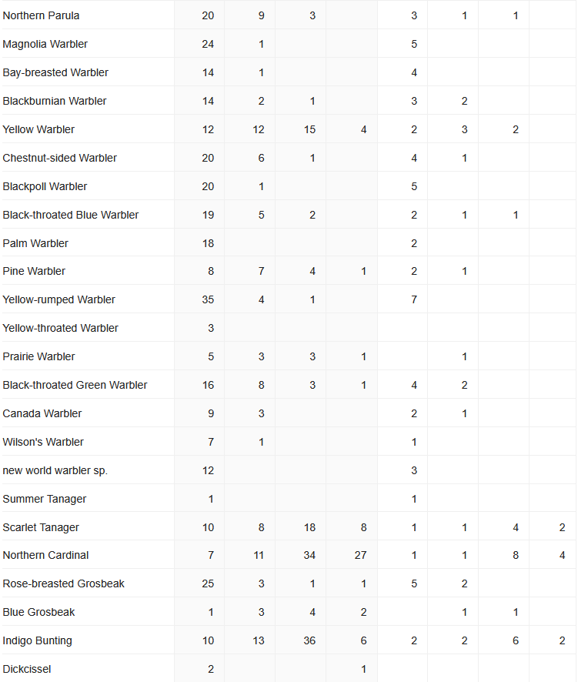
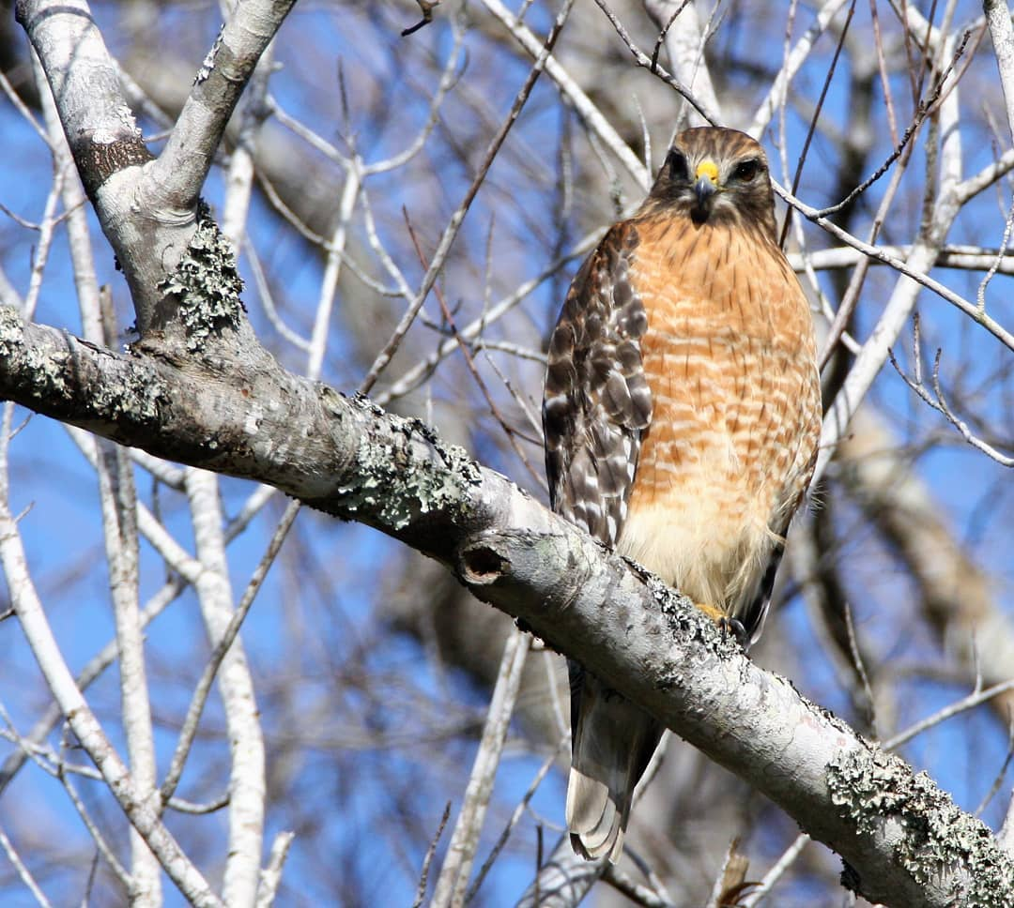
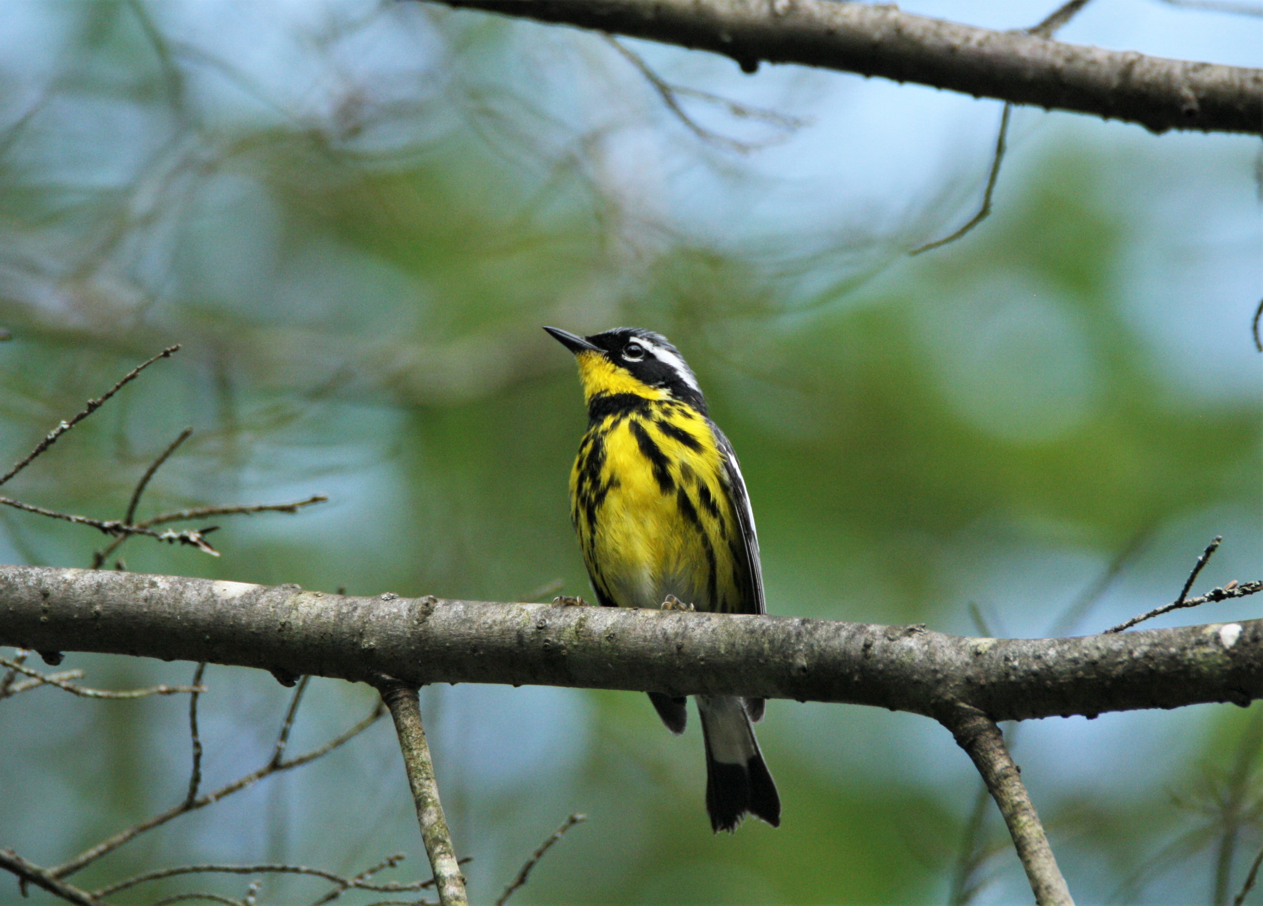

Slide 26
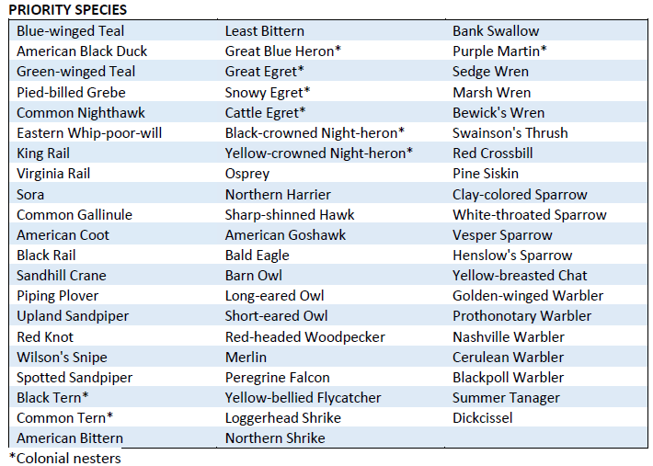
DOCUMENTING PRIORITY AND SENSITIVE SPECIES
If you observe a priority species, please:
1. Prioritize attempts to confirm breeding for the species in the block.
2. Provide additional information for the species in the species comments in your eBird checklist.
  • All priority species – Provide a specific location* of the bird and/or nest
  • You may also provide a brief description of the habitat, how you identified the bird, and details of nests (e.g., height above ground, species of tree/shrub, number of eggs/young present)
  • If possible, submit a photo or audio file
3. Colonial nesters – Provide the number of nests. *If you have concerns about providing a precise location, follow the guidelines for Sensitive Species.
Note: If you find a species that is not included on the Breeding Guidelines Chart (i.e., a new or historical breeding species), please treat it as a priority species.
Confirmed Year 1-Franklin Co.

Slide 27
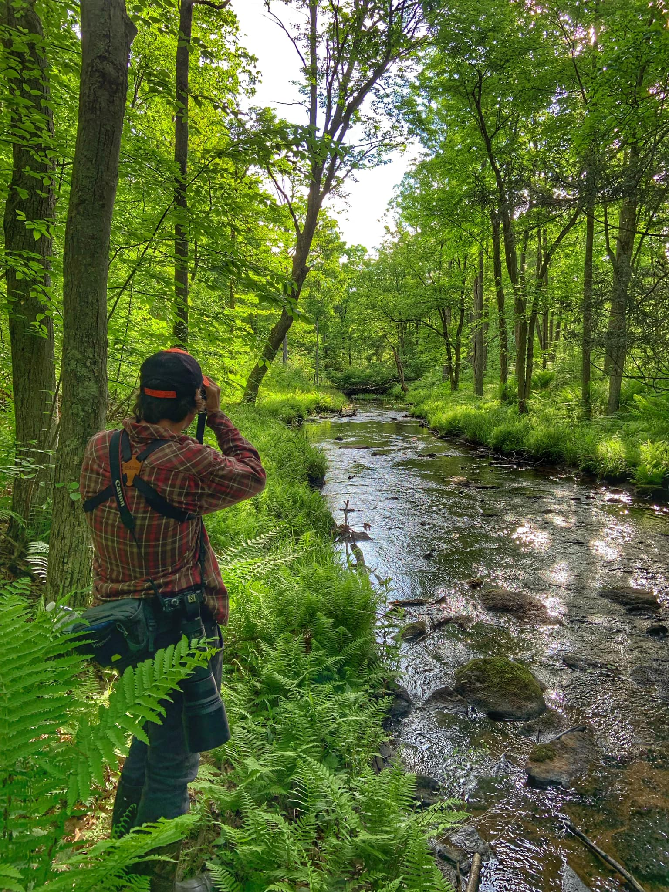
Franklin County Atlas Blocks that need help: 0-10 species coded

Slide 28
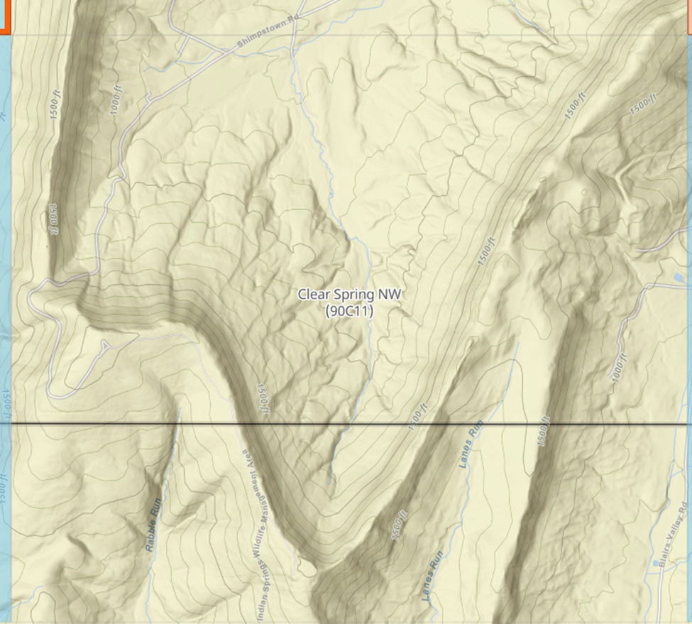
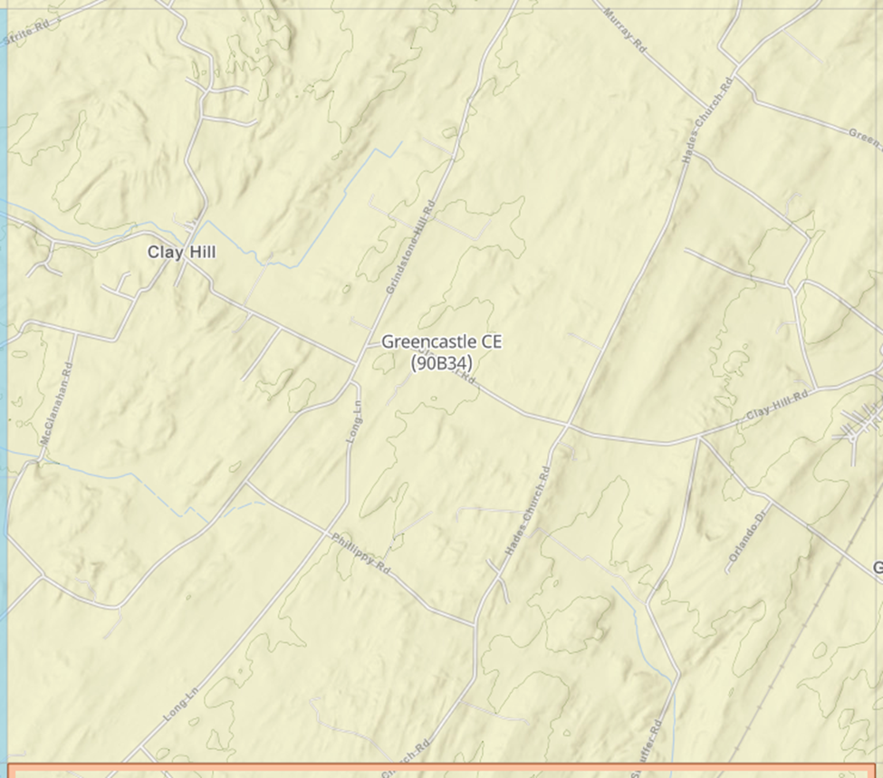
Clear Spring NW--not many access rds- Shrimpstown rd S, Mountain side dr (end)
Greencastle CE- Clay Hill rd, Grindstone Hill rd, Hades Church rd

Slide 29
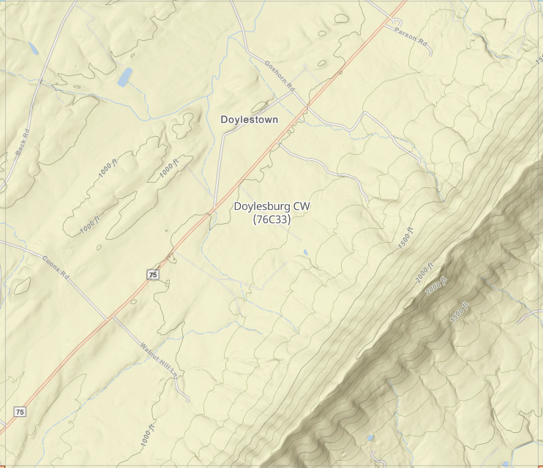
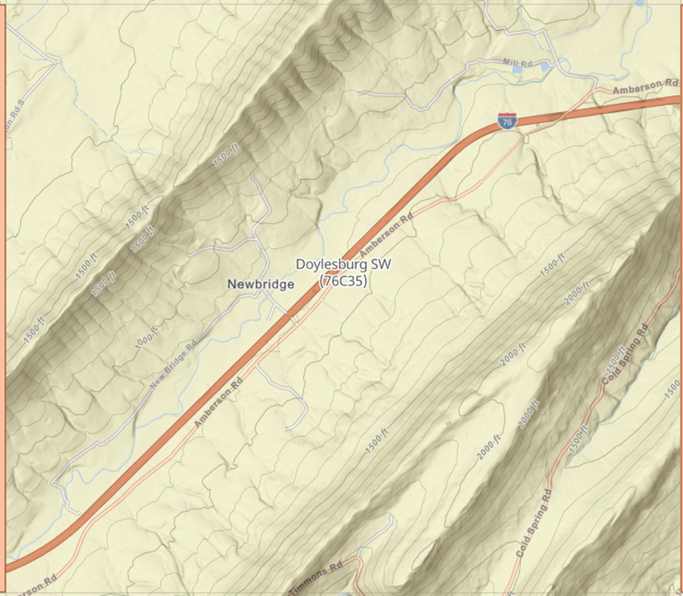
Doylesburg CW- Coons Rd, Route 75-Path Valley Rd, Goshorn Rd, Doylestown Rd
Doylesburg SW- Amberson rd, New Bridge rd, Cold Spring rd, Mill rd

Slide 30
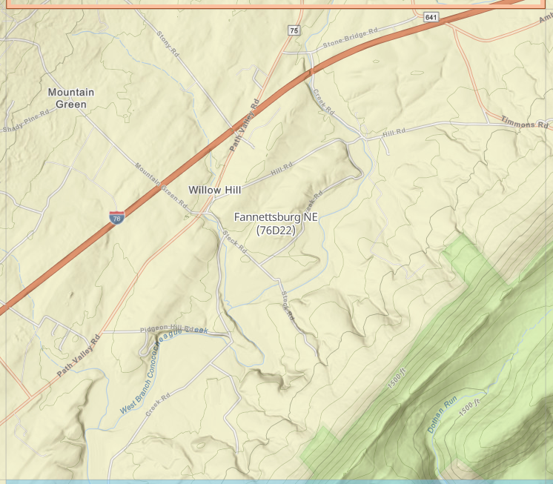
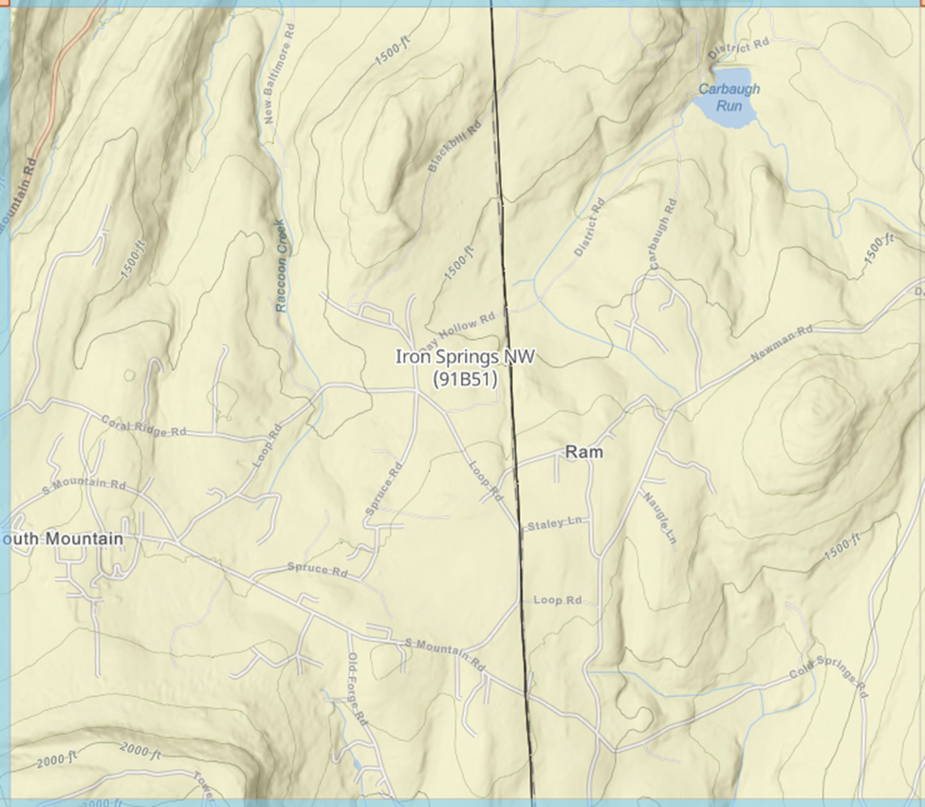
Fannettsburg NE- Hill rd, Timmons rdm pidgeon hill rd, mountain green rd, steck rd
Iron Springs NW- Carbaugh rd, Coral Ridge rd, Newman rd, S. Mtn rd.

Slide 31
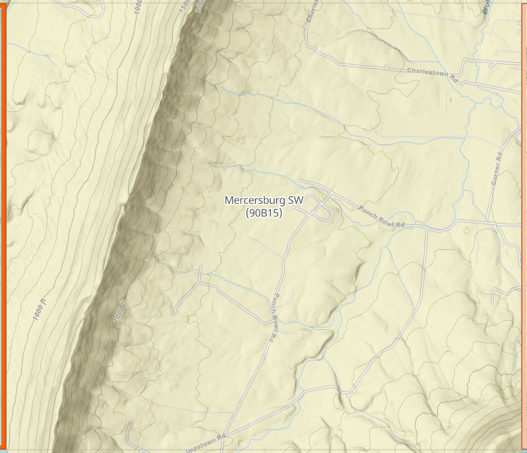
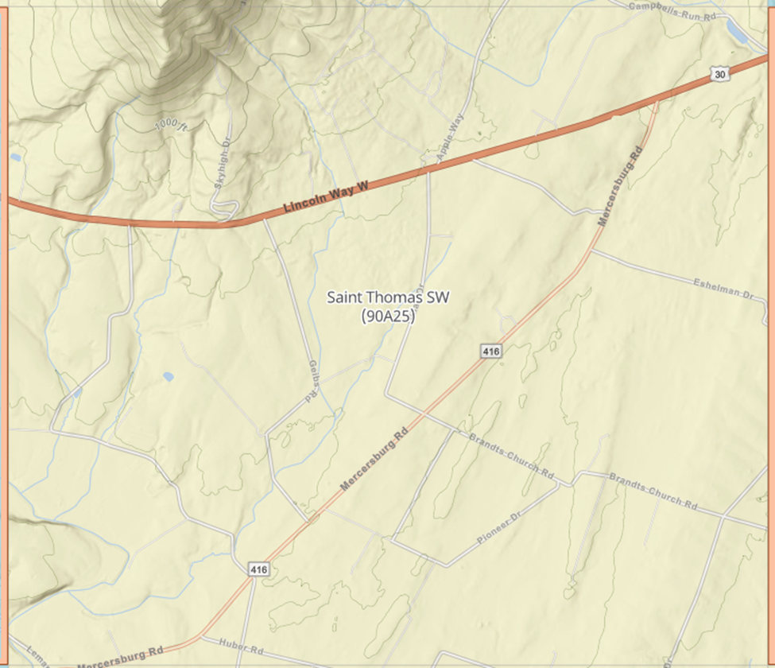
Mercersburg SW- Punch Bowl rd, Charlestown rd, Shrimpstown rd
Saint Thomas SW- Geibs rd, mercersburg rd, Mcdowell rd, brandts church rd

Slide 32
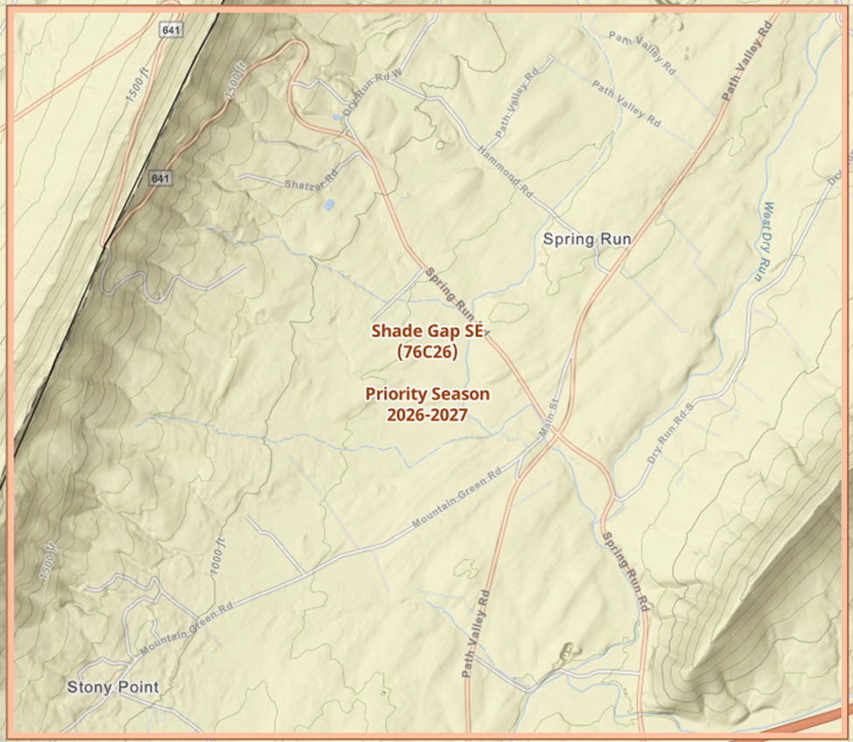
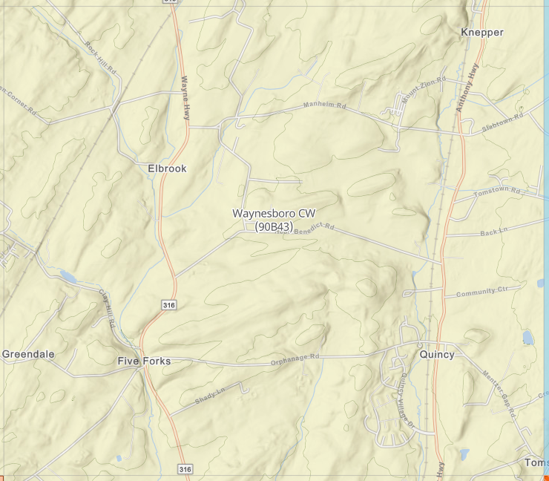
Shade Gap SE (P)- Spring run rd, Mountain Green rd, Hammond rd, Path Valley rd, Dry Run rd S.
Waynesboro CW- Heritage Park, Clay Hill Road, Orphanage rd, Hess Benedict rd

Slide 33
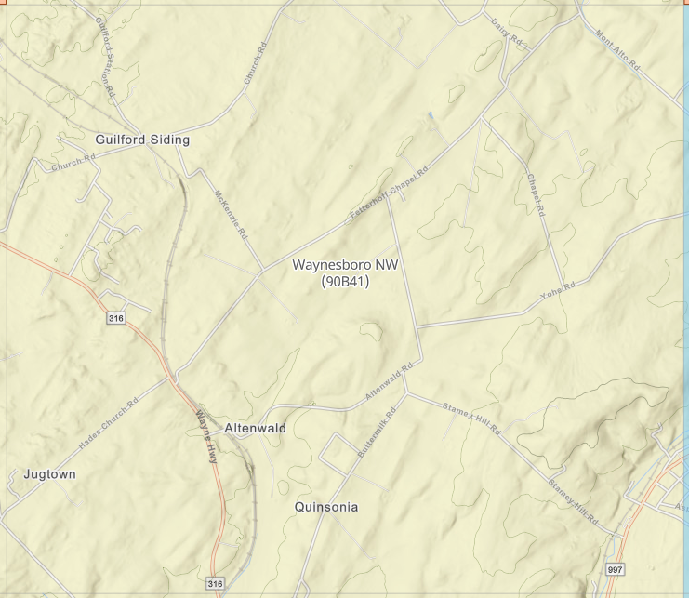
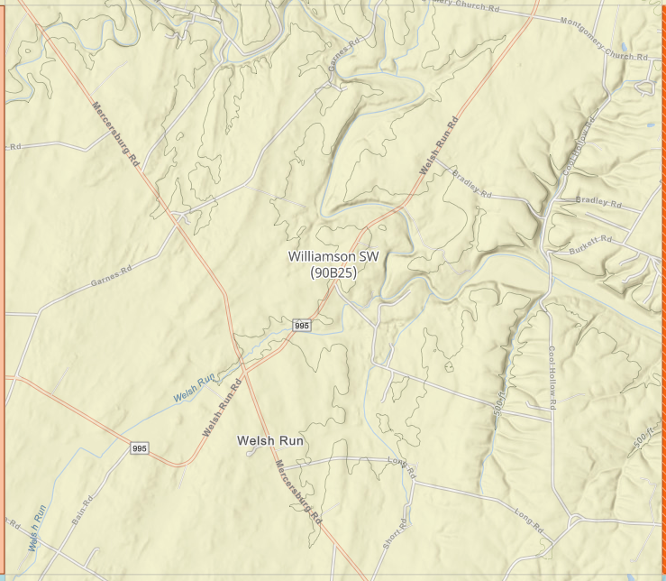
Waynesboro NW- Mckenzie rd, Fetterhoff Chapel rd, Church rd, Yohe rd
Williamson SW- Welsh run rd off 995,Long road, Cool Hollow rd

Slide 34
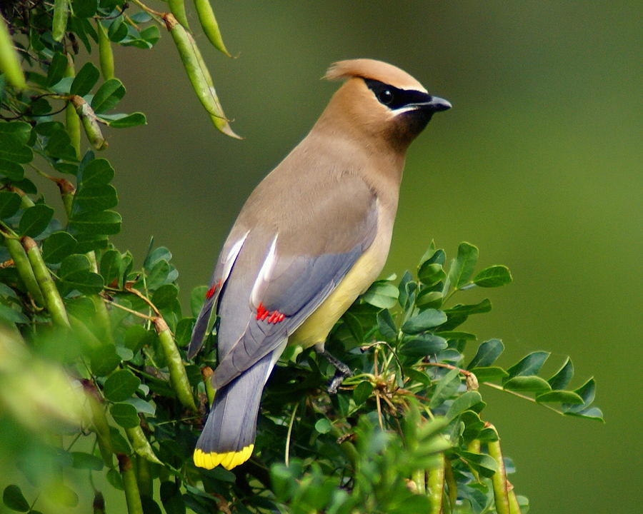
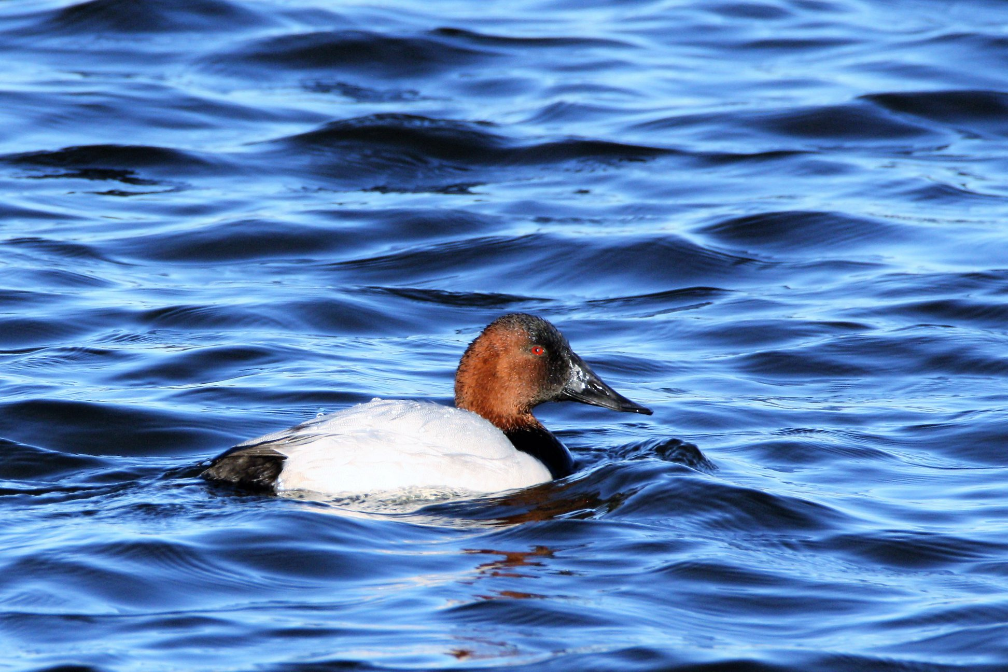
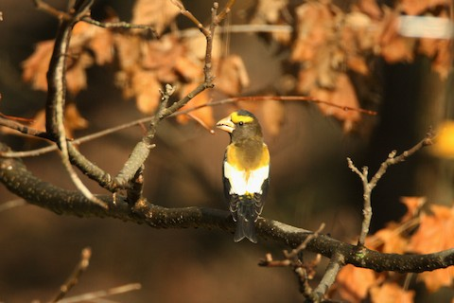

THANK YOU
Franklin Atlas Contributors:
Grace Muench
Eli Hevalow
Tracy Mosebey
Vern Gauthier
Ron and Tracy George-Snyder
John Hendell
Kurt Gaskill
Kai Victor
Brian Schmoke
Lori Nichols
Jason Schultz
Sean Herrmann
Tiffany Willow
Jason Kitting
Evan Vaeth
Ian Hess
Chad Kauffman
Mark Nale
Angela Romanczuk
Jeff Kenney
Chris Payne
Kevin Shannon
Joe Gyekis
Rebecca Payne
Tony Arnold
M Huston
Matthew Gerlach
Pol Heiney
Toy J
John Taylor
Mark Strittmatter
Ŕhetta Martin
David Wilson
Josh Donaldson
Susan Donaldson
Anir Bhat
Paul Foor
Jerry Warner
Asher Higgins
Annette Mathes
Cy Deitz
Nina Wolf
Warren Wolf
Barb Matthews
Doris Brookens
Erika Bowman
Darla Shank
W. Dwayne DelGrande
Franklin Co. Principal Atlasers:
Deuane Hoffman
Bill Oyler
Will Krohn
Bob Koontz
Andy Wilson
John Carter
David Cooney Jr
Kyle Rambo
Dave Ebbitt
Ian Clarke
Julie Maynard
Val Barnes
Peter Lusardi
Jessica Ferguson

Slide 35


"If you take care of birds, you take care of most of the environment problems in the world."
-Dr. Thomas Lovejoy

Slide 36

THANK
John Carter
carter0206@aol.com
You

